Slide 1


Best Meeting Ever Markit Medical
December 2017

Slide 2
Who is ChiPy
A monthly meeting for over 14 years in Chicago

Slide 3
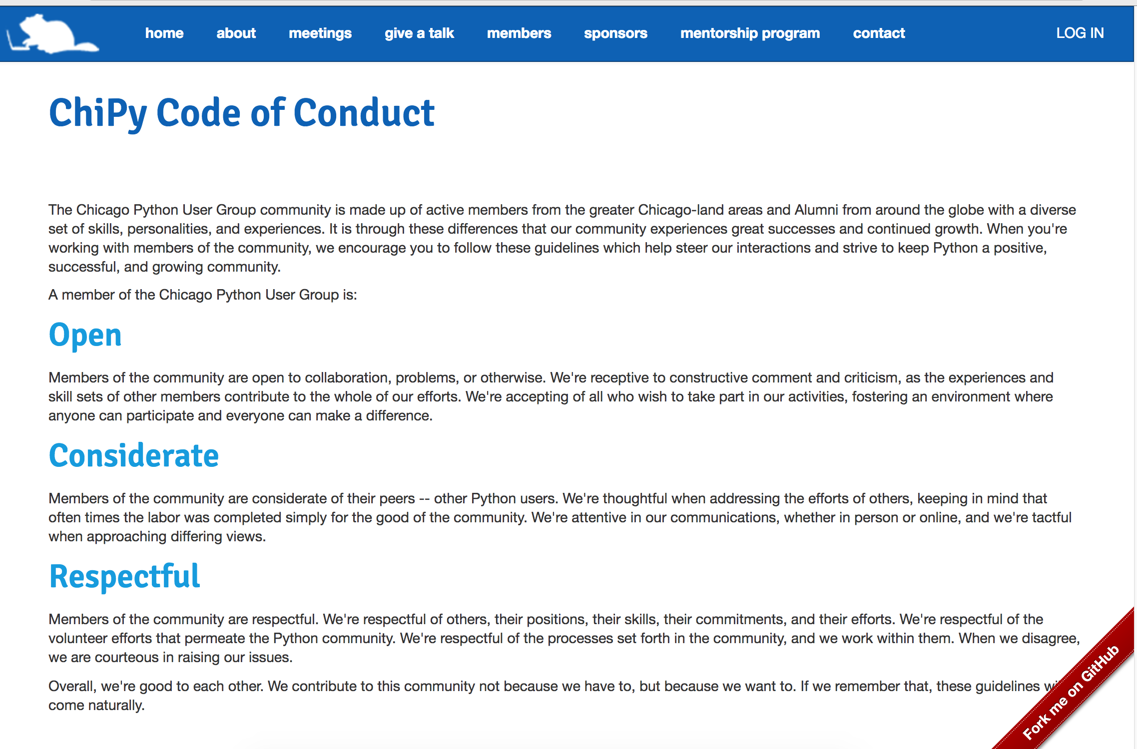
Code of Conduct
Code of Conduct
http://www.chipy.org/pages/conduct/

Slide 4
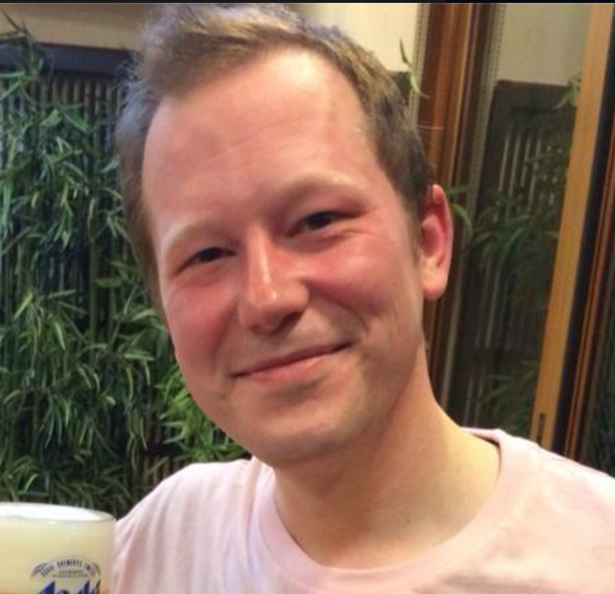
Organizers
Brian Adam B Jason Cezar Jerry Ray
Joe T Anjali Patrick

Slide 5

Meeting Sponsors

Slide 6





Sponsors
Sponsors
Diamond:
Platnimum:
Silver:

Slide 7
Where to find us
http://chipy.org (Join the mailing list RSVP for monthly meetings)
@ChicagoPython tweet with us
Github https://github.com/chicagopython/
http://www.meetup.com/_ChiPy_/ (RSVP for monthly or SIG meetings)

Slide 8

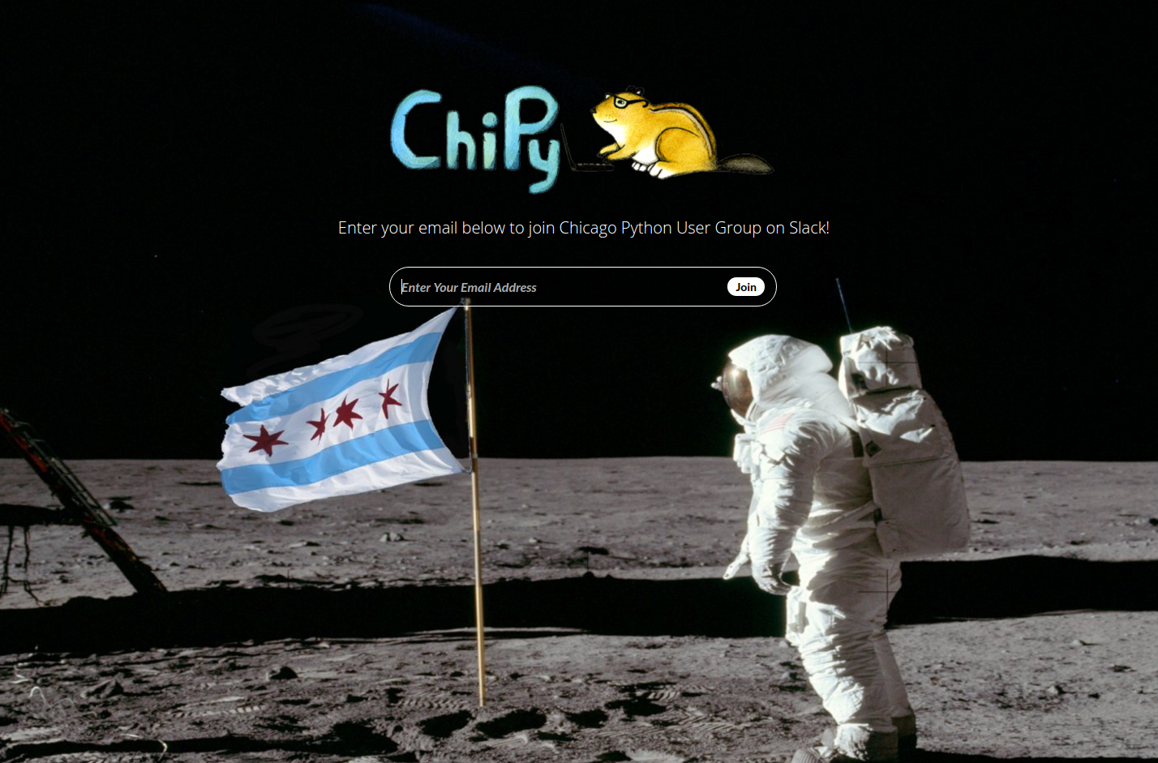
We’re on Slack!
How To Join: https://joinchipyslack.herokuapp.com/
Sign up link also available on www.chipy.org
Join a Room, Create Your Own, Interact with our amazing Community!

Slide 9
Line up
SQL indexes: what, why and how By: Chris Foresman
PyWeek24 - team development By: Michael Tamillow
(Title to come) By: Rob Roy Campbell

Slide 10
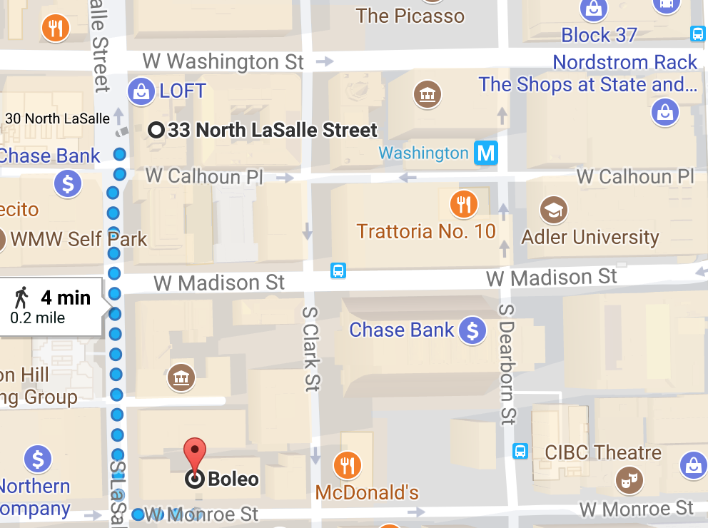
Announcements
AFTER PARTY:
Boleo in Kimpton Gray Hotel
122 W Monroe St, Chicago, IL 60603

